Slide 1

Machine Learning Fundamentals
Gabriel Balaban

Slide 2
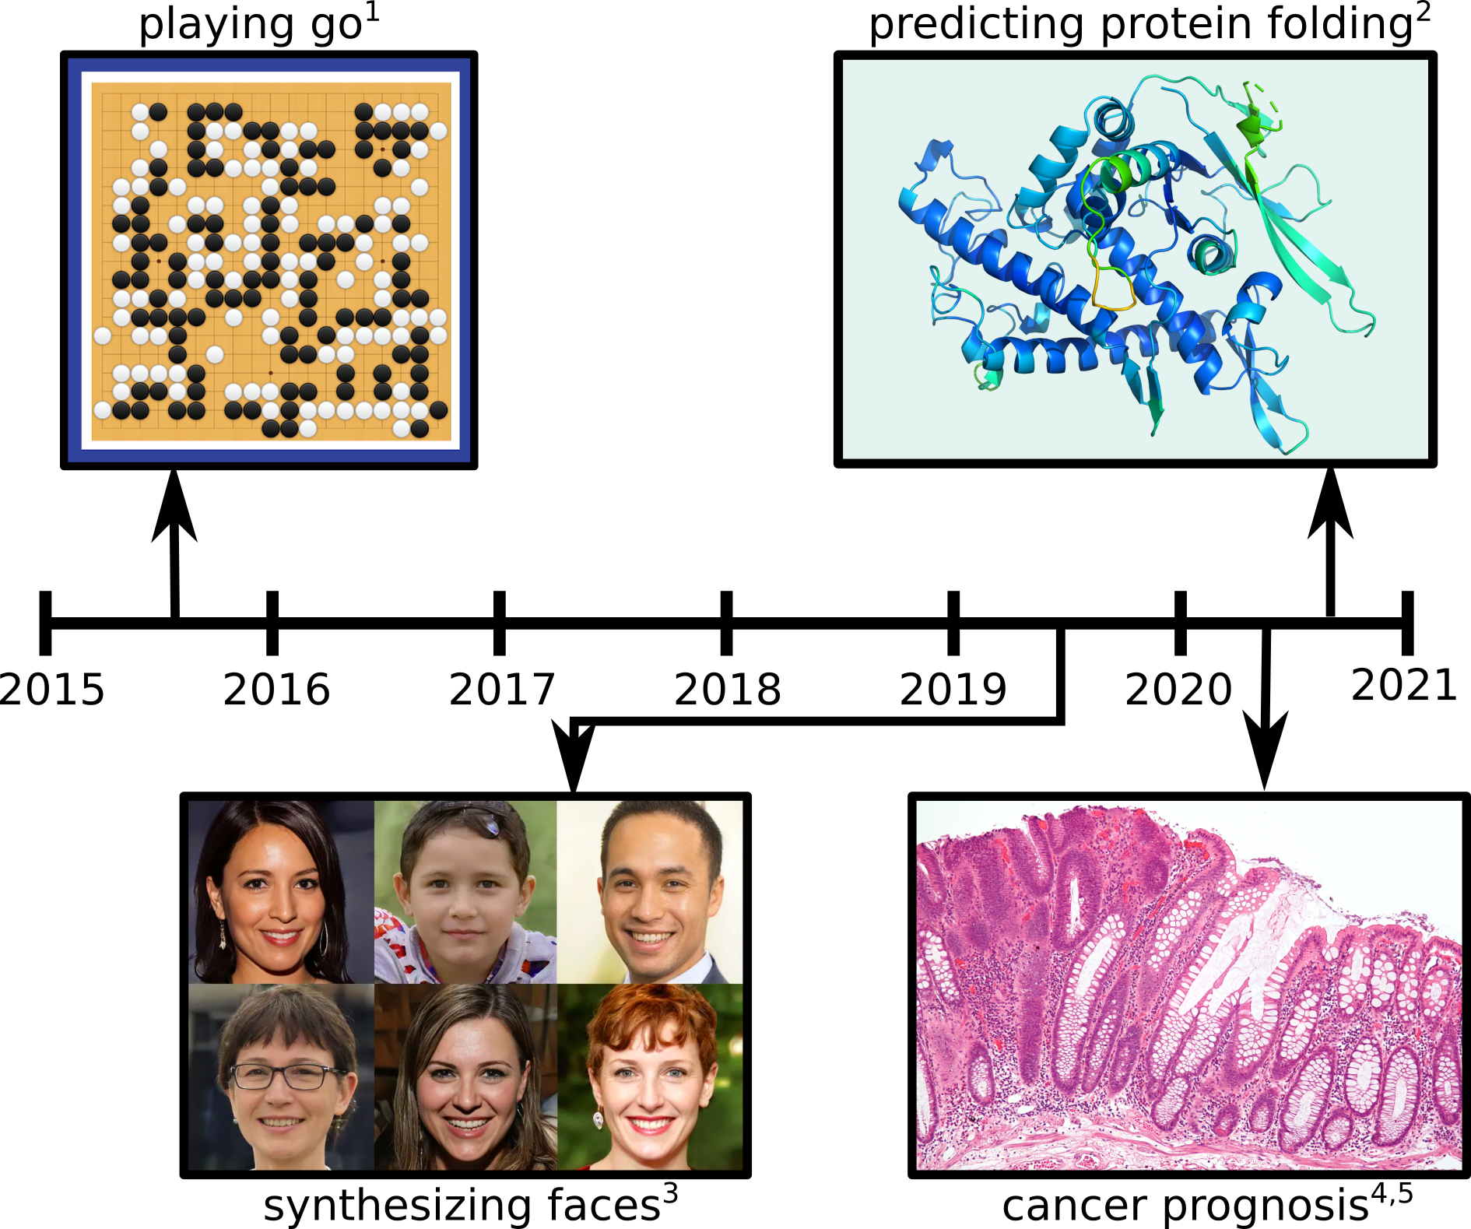
Machine Learning techniques have powered many recent technological breakthroughs
1) https://deepmind.com/research/case-studies/alphago-the-story-so-far
2) https://deepmind.com/blog/article/alphafold-a-solution-to-a-50-year-old-grand-challenge-in-biology
3) Karras T, Laine S, Aila T. A style-based generator architecture for generative adversarial networks.
4) Skrede OJ et al. Deep learning for prediction of colorectal cancer outcome: a discovery and validation study.
5) Image source: Nephron, https://commons.wikimedia.org/w/index.php?curid=8273894

Slide 3

Definition:
Machine learning is a branch of artificial intelligence focused on building applications that learn from data and improve their accuracy over time without being programmed to do so.
Spam filter: Hard to program but straight-forward to train using machine learning

Slide 4
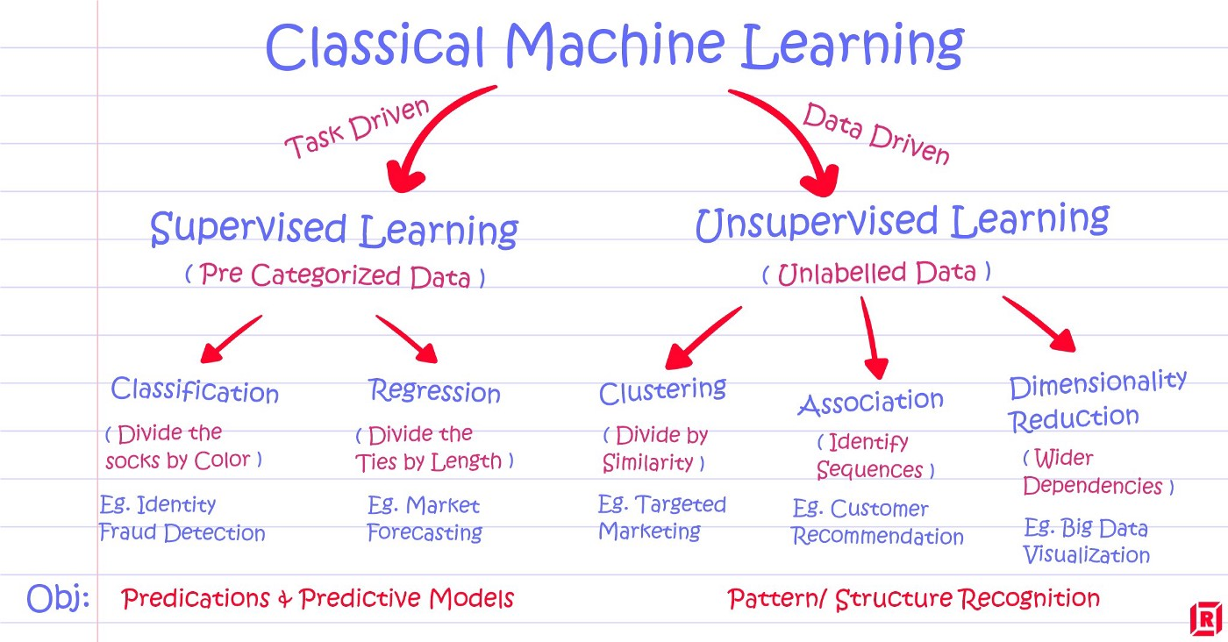
Machine Learning algorithms are often classified by how much “supervision” they require
Source medium.com/@dkatzman

Slide 5
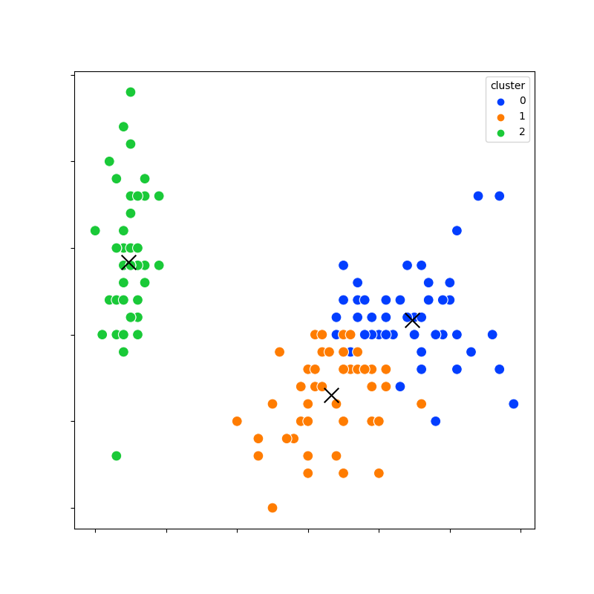
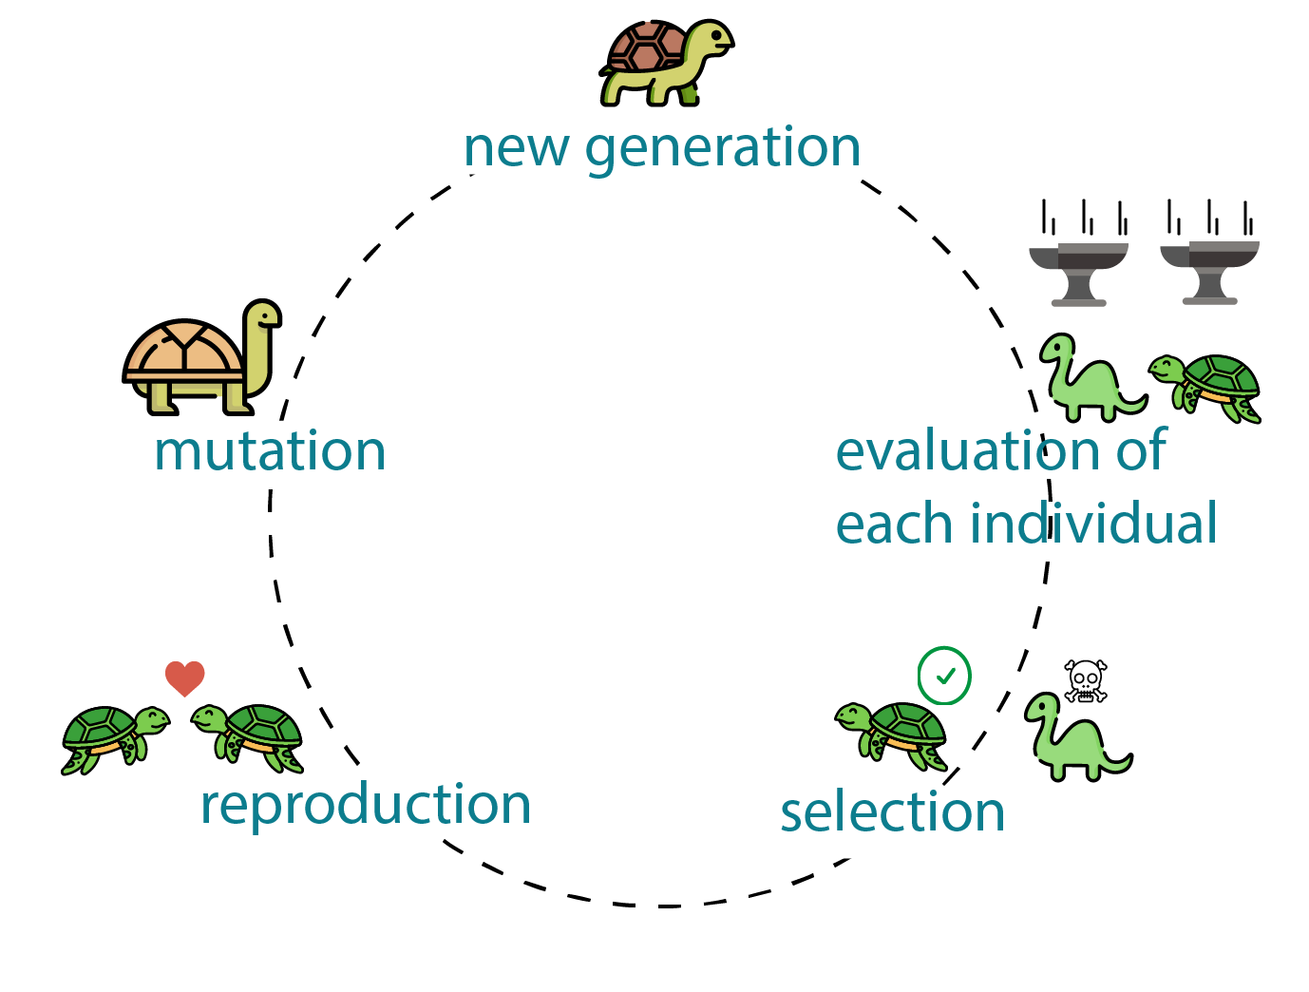
In this module you will learn about 2 fundamental machine learning strategies
K-means clustering | Genetic Algorithms

Slide 6
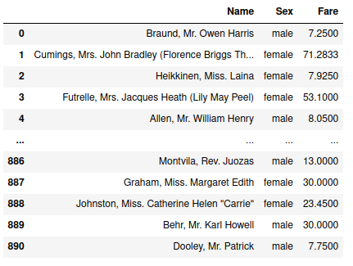
To complete the exercises you will need basic data manipulation skills for tabular data
Tabular Data
pandas https://pandas.pydata.org/

Slide 7


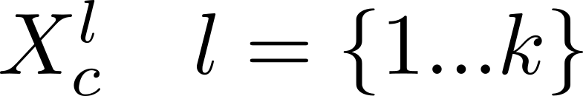
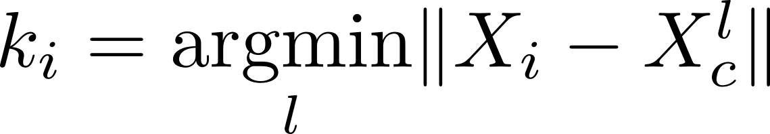
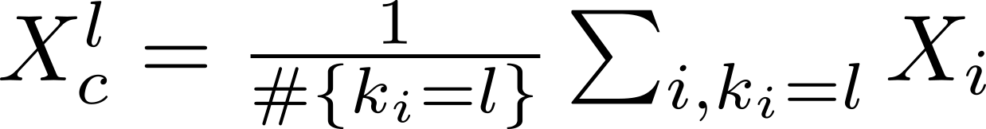
K-means clustering is a fundamental algorithm to find clusters in data
= data matrix (num datapoints x num features)
Given
Want class membership
= vector of (num datapoints)
K-means algorithm
Initialize cluster centres
Iterate until convergence
1)
2)

Slide 8
Genetic algorithms are a biologically inspired framework for generating “good enough” solutions to difficult problems
Source generativedesign.org

Slide 9
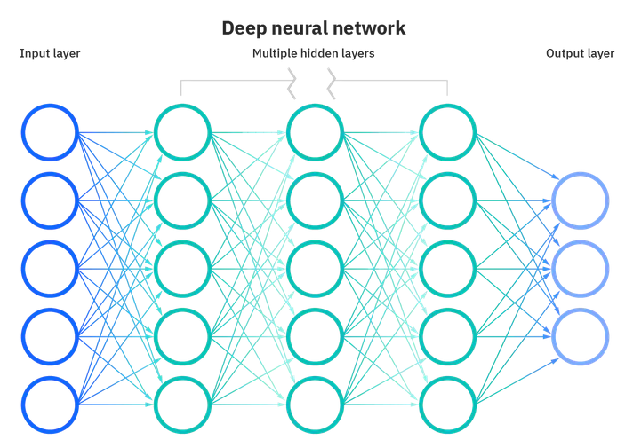
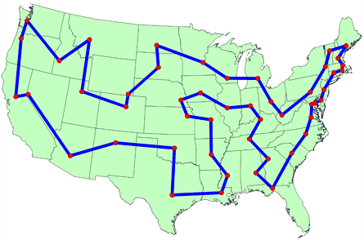
Combinatorial optimization problems are often NP-Hard and cannot be solved efficiently by brute force
Traveling salesman problem
Neural network design
What is the shortest route through n cities,
visiting each city once, and starting and
ending In the same city ?
What is the best layout of nodes for a given machine learning
problem?
Brute force approach requires (n-1)!
route length evaluations

Slide 10
Genetic algorithms can create good enough solutions to the traveling salesman problem
Traveling salesman problem
[Start] Generate random population of chromosomes
[Fitness] Evaluate the fitness of each chromosome x
[New population] Create a new population by repeating
the following steps until new population complete
[Selection] Select two parent chromosomes according
to fitness
[Crossover] With a crossover probability cross parents to
form children. If no crossover, children are copies of parents
[Mutation] With a mutation probability mutate offspring
at each locus
[Replace] Use new population for a further run of the algorithm
[Test] If end condition stop and return the current best solution
What is the shortest route through n cities?

Slide 11
A chromosome for the travelling salesman problem is a list of cities, the fitness function is the Euclidean distance
[Start] Generate random population of chromosomes
[Fitness] Evaluate the fitness of each chromosome x
[New population] Create a new population by repeating
the following steps until new population complete
[Selection] Select two parent chromosomes according
to fitness
[Crossover] With a crossover probability cross parents to
form children. If no crossover, children are copies of parents
[Mutation] With a mutation probability mutate offspring
at each locus
[Replace] Use new population for a further run of the algorithm
[Test] If end condition stop and return the current best solution
Chromosome
$x_{j}=coordinatesofcityj$
Note: drop first and last entry to get permutation
Fitness Function
$f\left(c^{i}\right)=\sum_{j=1}^{numcities}{d\left(x_{j}−x_{j−1}\right)}$
$d=Euclideandistance$

Slide 12
Many possible mutation and crossover functions can be defined for the travelling salesman problem The main constraint is that we need to create valid permutations
Crossover
[Start] Generate random population of chromosomes
[Fitness] Evaluate the fitness of each chromosome x
[New population] Create a new population by repeating
the following steps until new population complete
[Selection] Select two parent chromosomes according
to fitness
[Crossover] With a crossover probability cross parents to
form children. If no crossover, children are copies of parents
[Mutation] With a mutation probability mutate offspring
at each locus
[Replace] Use new population for a further run of the algorithm
[Test] If end condition stop and return the current best solution
parent
parent
?
child
child
Mutation
Swap cities at two random locations
mutant

Slide 13
The travelling salesman crossover operation is tricky. How would you solve it?

